Slide 1
Chapter 7
HYPOTHESIS TESTING WITH Z TESTS

Slide 2
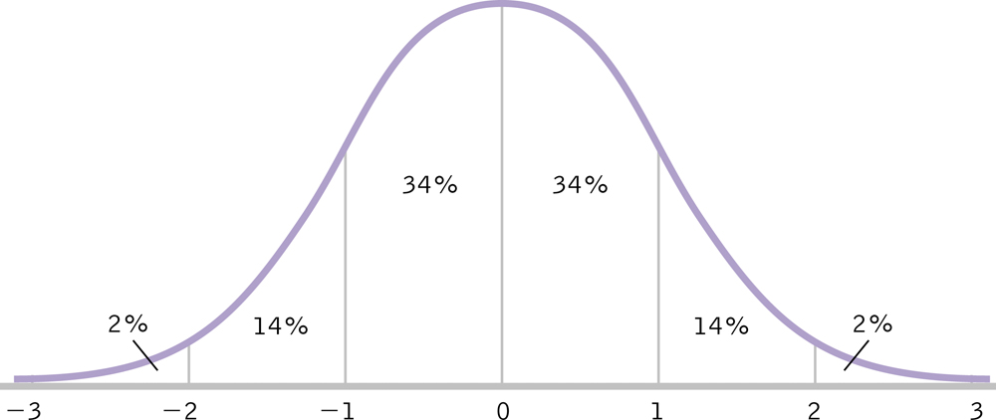
The z Table
Remember…
  z distribution is mathematically defined
  percentage below any given point in the z distribution is known

Slide 3
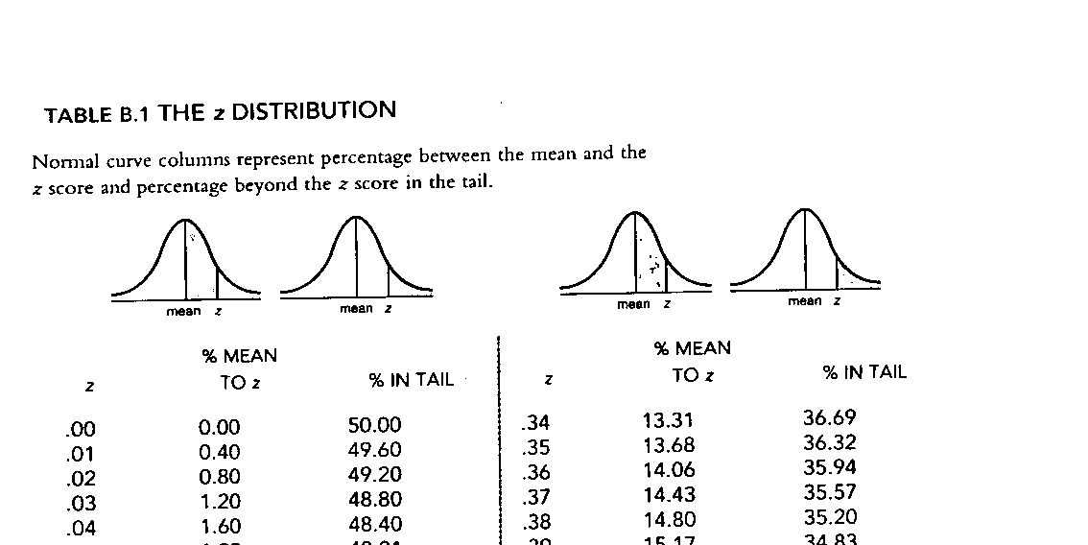
The z Table
Can determine the percentage associated with any given z value by
  1. Converting raw score to z score
  2. Look up z score in z table (pp. B1-B3)

Slide 4
Example
μ_{boys} = 67.00; σ_{boys} = 3.19
μ_{girls} = 63.80; σ_{girls} = 2.66
“short” = bottom 5% of heights
“average” = middle 90% of heights
“tall” = top 5% of heights

Slide 5
Calculating the Percentile for a Positive z Score
Jessica, 66.41 inches tall
X – μ
66.41 – 63.80
z =
z =
σ
2.66
= 0.98

Slide 6
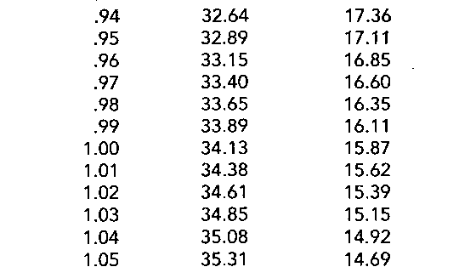
Jessica’s Percentile Rank
Jessica’s percentile is 50% + 33.65% = 83.65%

Slide 7
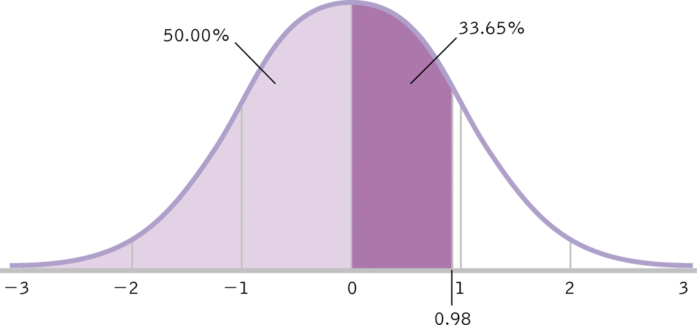
Jessica’s Percentile Rank

Slide 8
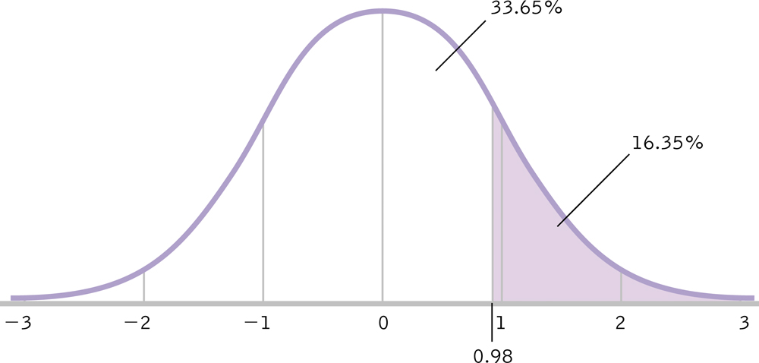
Percentage of Scores above Jessica
50% - 33.65% = 16.35%

Slide 9
Example
μ_{boys} = 67.00; σ_{boys} = 3.19
μ_{girls} = 63.80; σ_{girls} = 2.66
“short” = bottom 5% of heights
“average” = middle 90% of heights
“tall” = top 5% of heights
Jessica is of average height

Slide 10
Calculating the Percentile for a Negative z Score
Manuel, 61.20 inches tall
X – μ
61.20 – 67.00
z =
z =
σ
3.19
= - 1.82

Slide 11
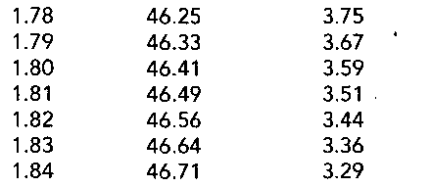
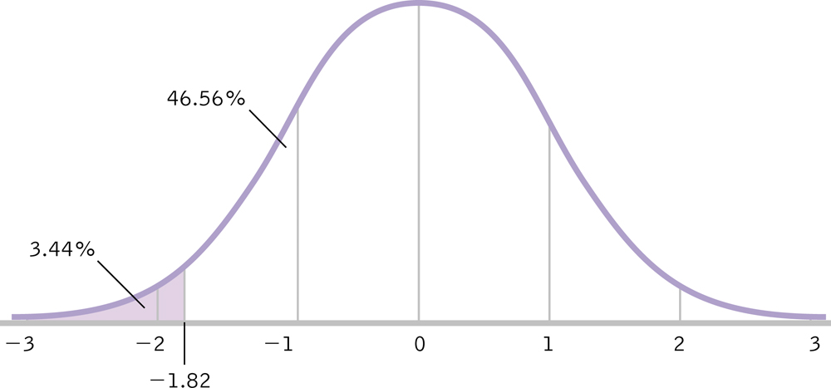
Manuel’s Percentile Rank
50% - 46.56% = 3.44%

Slide 12
Example
μ_{boys} = 67.00; σ_{boys} = 3.19
μ_{girls} = 63.80; σ_{girls} = 2.66
“short” = bottom 5% of heights
“average” = middle 90% of heights
“tall” = top 5% of heights
Manuel is short

Slide 13
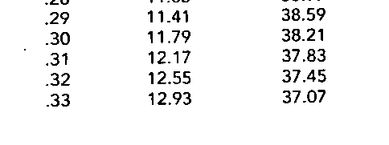
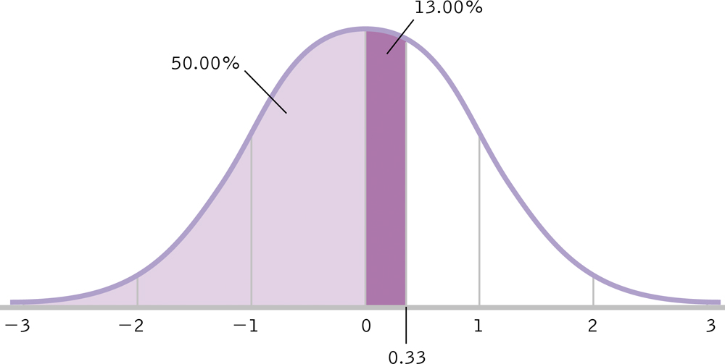
Calculating a Raw Score from a Percentile
SAT exam: μ = 500; σ = 100
Jo scored at the 63rd percentile
What was her raw score?

Slide 14
Calculating a Raw Score from a Percentile
X – μ
X – 500
z =
0.33 =
σ
100
= 533

Slide 15
The z Table and Distributions of Means
M – μ_{M}
z =
σ_{M}

Slide 16
Example
IQ scores: μ = 100; σ = 15
IV: brain “exercises” for 3 months
N = 90
M = 102
M – μ_{M}
102 – 100
= 1.27
z =
z =
σ_{M}
1.58

Slide 17
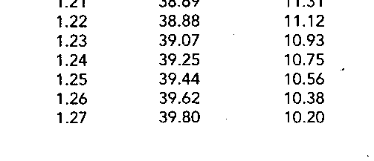
Percentile Rank of our Sample
50% + 39.80% = 89.80%
Only 10.2% of mean scores would be higher than our mean if they came from the identified population
Our sample mean is pretty high
But, we need hypothesis testing to draw a conclusion about whether our brain exercises produced significantly higher IQs

Slide 18
Assumptions for z Test
1. DV is a scale measure (i.e., interval or ratio)
2. Participants are randomly selected from the population
3. Distribution of the population must be approximately normal

Slide 19
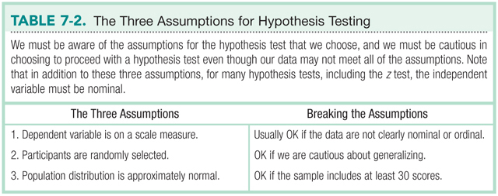
Assumptions for z Test

Slide 20
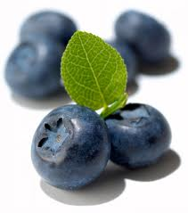
The z Test
Use when you want to test a sample against a population with known μ and σ
Can the antioxidants in foods (such as blueberries) reduce age-related declines in cognitive functioning?

Slide 21
Step 1: Identify
Populations
  General population of older adults (> 65 yrs old)
  Population of older adults given a blueberry supplement
Comparison distribution
  Distribution of means
Hypothesis test
  z test (one sample, compared to known population parameters)
Assumptions
  DV is score on neuropsychological test (interval)
  Convenience sample
  N = 30

Slide 22
Step 2: H₀ & H₁
H₀ : No difference between populations
  H₀ : μ₁ = μ₂
H₁ : There is a difference between populations
  H₁ : μ₁ ≠ μ₂

Slide 23
Step 3: Identify the Sampling Distribution
μ_{M} = μ = 80
σ_{M} = 20 / √30 = 3.65
σ_{M}=
σ
√ N

Slide 24
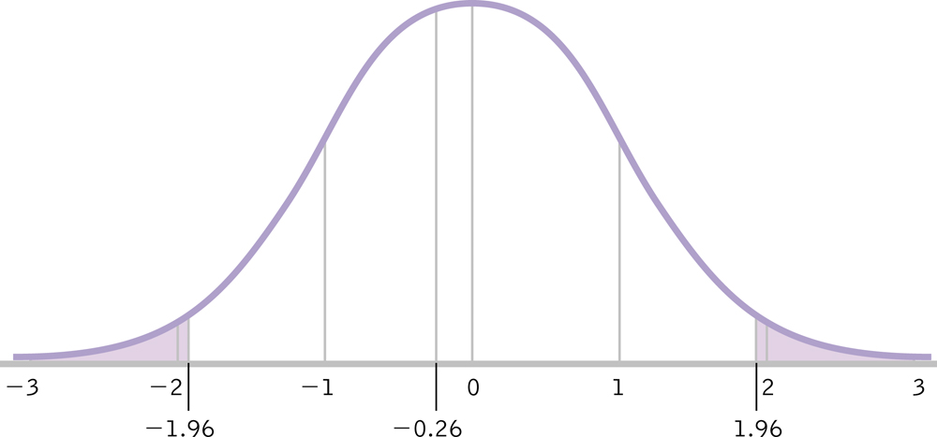
Step 4: Determine Critical Values
how extreme our data must be to reject the null hypothesis
typically set at 5%
α = .05

Slide 25
Step 5: Calculate z
M – μ_{M}
92 – 80
= 3.29
z =
z =
σ_{M}
3.65

Slide 26
Step 6: Make a Decision
3.29
Is the calculated z in the rejection region? YES

Slide 27
Step 6: Make a Decision
H₀ : μ₁ = μ₂
H₁ : μ₁ ≠ μ₂
Blueberry supplement had an effect on cognitive functioning.
Blueberry supplement resulted in a statistically significant improvement in performance, z = 3.29, p < .05

